Slide 1
More MS PowerPoint
Dynamics
Notes:
MS PowerPoint Training Handbook
© AIG Systems Solutions
Employee Name:
Trainer Name:
Date of Training:

Slide 2
Session 3
Notes:
MS PowerPoint Training Handbook
© AIG Systems Solutions

Slide 3
Objective
This session covers concepts using PowerPoint to incorporate graphics and animation into the presentations, setting up customs shows, controlling presentation, rehearsing timings, handling shapes and objects, usage of sound and video etc.
Notes:
MS PowerPoint Training Handbook
© AIG Systems Solutions

Slide 4
Custom Shows
PowerPoint's Custom Shows feature allows you to create a presentation within a presentation. Instead of creating multiple, nearly identical presentations for different audiences, you can group together and name the slides that differ and then jump to these slides during your presentation.
For example, you might want to give a presentation to two groups that work at two different sites. The slide show includes slides 1 through 10, which are identical for both groups, and two Custom Shows, each specific to one of the sites.
You can show the first 10 slides to both groups and then jump to a Custom Show named "Site 1" for the first group and to a Custom Show named "Site 2" for the second group.
You can jump to a Custom Show by using the Action Settings dialog box (Slide Show menu) to set up a hyperlink to the show. Or, during a presentation, you can right-click, point to Go on the shortcut menu, point to Custom Show, and then click the show you want
Notes:
MS PowerPoint Training Handbook
© AIG Systems Solutions

Slide 5
Controlling a Presentation
F5 – From Start of the Presentation
Shift +F5 – Current Slide
Saving a Presentation
.ppt – PowerPoint Presentation file
.pps – PowerPoint Slide Show (exe)
.pot – PowerPoint Template
Hiding a Slide
Slide Show Menu | Hide Slide
Notes:
MS PowerPoint Training Handbook
© AIG Systems Solutions

Slide 6

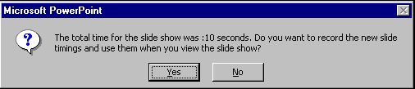
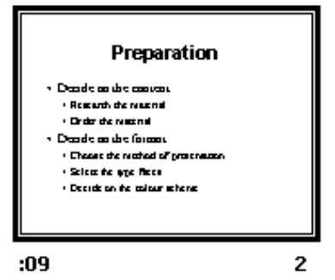
Rehearsing Timings
Slide Show | Rehearse Timings
Time elapsed for current slide
Running the timed slide show
Slide Show | View Show
The show will run from the first to the last slide automatically, at the rate determined by the recorded times.
To stop the show before the end, press the Esc key.
To turn off the automatic timings on the Slide Show menu click Set Up Show and choose to advance slides manually
Play button
Time elapsed for whole show
Pause button
Recorded timing
Notes:
MS PowerPoint Training Handbook
© AIG Systems Solutions

Slide 7
Slide Show controls
To | Do this
Advance to the next slide | Click the mouse
Return to the previous slide | Press Backspace
Go to a slide | Type the slide number, and then press Enter
Black or unblack the screen | Press B
White or unwhite the screen | Press W
Show or hide the arrow pointer | Press A
Stop/Restart Automatic Show | Press S
End slide show | Press Esc
Erase drawing on-screen | Press E
Go to next slide, if it's hidden | Press H
Rehearse with new timings | Press T
Rehearse with original timings | Press O
Rehearse with mouse-click advance | Press M
Return to the first slide | Hold both mouse buttons down for 2 seconds
Change pointer to pen | Ctrl+P
Change pen to pointer | Ctrl+A
Hide pointer and button | Ctrl+H
Hide pointer and button always | Ctrl+L
Display shortcut menu | Right mouse-click
Notes:
MS PowerPoint Training Handbook
© AIG Systems Solutions

Slide 8
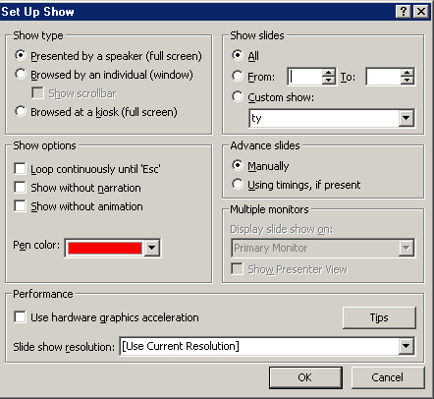
Self-running Presentations
Slide Show | Set Up Show
Notes:
MS PowerPoint Training Handbook
© AIG Systems Solutions

Slide 9
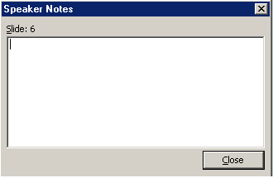
Creating notes during a slide show
During a slide show, click the right mouse button, and then select Screen / Speaker Notes
Type in the space provided on the tab and click Close.
Notes:
MS PowerPoint Training Handbook
© AIG Systems Solutions
Demo for Notes

Slide 10
Diagrams and Organisation charts
To include a diagram or organisation chart in your presentation, you should consider using the content layouts that PowerPoint provides.
Also, the Diagram Toolbar could be used to create diagrams of your choice.
There are several pre-designed diagrams and organisation charts in PowerPoint:
  Organisation charts – to represent an organisation’s structure or hierarchy
  Cycle diagram – to show a process with a continuous cycle
  Radial diagram – to show relationships to a core element
  Pyramid diagram – to show foundation relationships
  Venn diagram – to show areas of overlap between elements
  Target diagram – to show steps towards a goal.
Notes:
MS PowerPoint Training Handbook
© AIG Systems Solutions

Slide 11
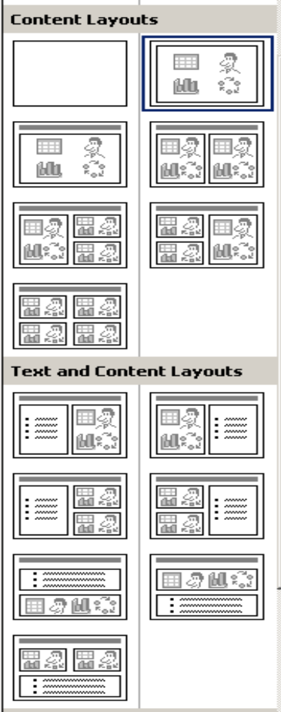
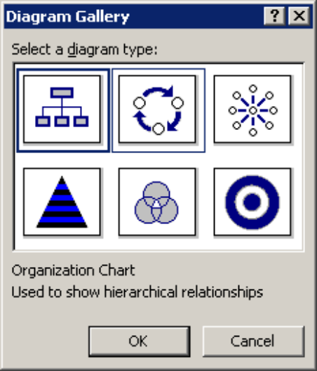
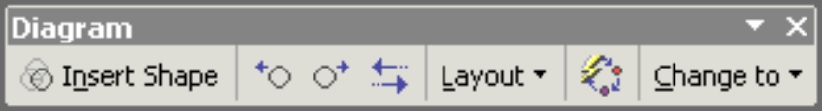
Creating a diagram or chart using content layout
2 content layout allows you to have 2 objects side by side. There are other combinations of layout you can use, see the Diagram Gallery window on the left.
Changing a diagram type : To change the type of a diagram (e.g. from Cycle to Venn), use the Change to button on the Diagram toolbar
Notes:
MS PowerPoint Training Handbook
© AIG Systems Solutions

Slide 12

Tables
There are several ways to create a table in a PowerPoint presentation.
Create Simple tables inside PowerPoint
Slide Layout Task Pane | Other Layouts | select Title and Tables Layout
Double click on the icon to specify the number of rows and columns and click OK.
Create Complex tables inside PowerPoint
1. Display the Tables and Borders toolbar by clicking on the Tables and Borders button on the Standard toolbar.
2. Click on the Draw Table button
3. The pointer changes to pencil shape.
4. To define the outer table boundaries, drag diagonally to the size you need. Then drag to create the column and row boundaries.
5. To erase a line, click Eraser and then click on the line
Notes:
MS PowerPoint Training Handbook
© AIG Systems Solutions

Slide 13
Other Formatting on the Tables
Change the style of the border
Change the width of the border
Change the colour of the border
Add rows or columns to a table
Delete table rows or columns
Merge or split cells in a table
Position or align text in a table
Change cell margins
Insert a tab in a table cell -------Ctrl +Tab
Rotate text in tables
Notes:
MS PowerPoint Training Handbook
© AIG Systems Solutions

Slide 14
Create an embedded Word table
On the Insert menu, click Object.
In the Insert Object dialog box, click Create New.
In the Object type box, select the Microsoft Word Document, and then click OK.
Use the commands on the Table menu to create the table.
Click outside the table to return to PowerPoint.
Insert Excel worksheet cells into a presentation
Copy cells from Excel and paste
Copy cells from Excel and Paste Special – for auto updation of values (creates a link between
Excel cells and current table.
Notes:
MS PowerPoint Training Handbook
© AIG Systems Solutions

Slide 15
Charts
Works using Microsoft Charts.
Created from Chart Layout.
Could be copied and pasted.
Could be copied and Paste Special (Link)
Changing the chart type
Link or embed an Excel chart
Creating a linked or embedded Excel chart from an existing file
Notes:
MS PowerPoint Training Handbook
© AIG Systems Solutions

Slide 16
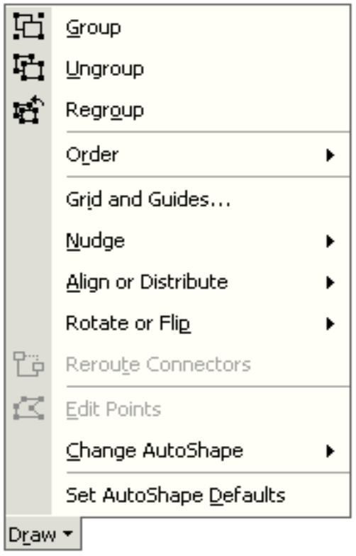
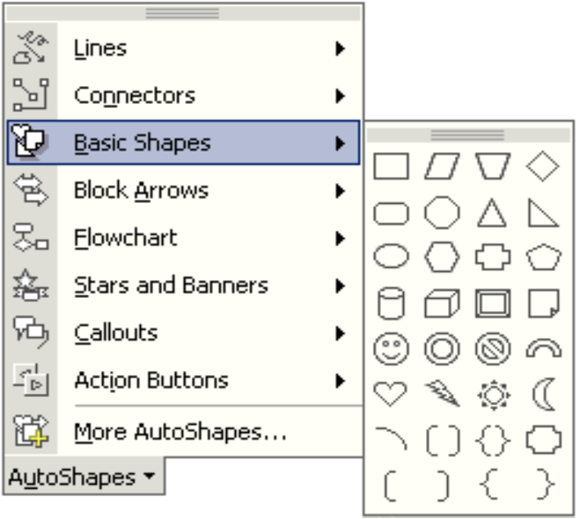
Drawing Tools
AutoShapes
Menu
Draw menu
Notes:
MS PowerPoint Training Handbook
© AIG Systems Solutions

Slide 17
Working with Shapes
Adding Shapes
Applying Shadow effect.
Applying 3 D Effect.
Duplicate Shapes --- Ctrl + D or Ctrl + Hold drag the object to new location
Free Hand Drawing
Notes:
MS PowerPoint Training Handbook
© AIG Systems Solutions

Slide 18
Working with Objects
Aligning objects with other objects
Align objects in relation to the slide
Align objects with guides.
Align objects on a grid.
Arrange objects to be equally distanced from each other.
Stacking objects
Grouping, ungrouping and regrouping objects
Word Art
Notes:
MS PowerPoint Training Handbook
© AIG Systems Solutions

Slide 19
Sound clips and videos
Inserting a sound or video clip from the Clip Gallery.
Inserting a sound from another location.
Adding a sound clip to an object or existing text.
Activating the clip during the slide show.
Notes:
MS PowerPoint Training Handbook
© AIG Systems Solutions

Slide 20
Activity
Create a PowerPoint presentation specific to any topic in your project / work incorporating all the features learned in Session 1, Session 2 and Session 3.
Evaluation Criteria
Professional Flow of the presentation
Usage of appropriate features.
Choice of using appropriate features.
Explanation of the same.
Minimum of 10 slides to be present.
Notes:
MS PowerPoint Training Handbook
© AIG Systems Solutions

Slide 21
Thank You
Notes:
MS PowerPoint Training Handbook
© AIG Systems Solutions

